Slide 1






MULTI-FUNCTIONAL SAFETY DEVICE
IOT-BASED

Slide 2





PROJECT
OVERVIEW
•This project focuses on designing a multi-purpose IoT-based security device.
•Features include detecting sound, flame, gas, vibrations, and sending real-time notifications.
•To create an adaptive, cost-efficient, and reliable security system for diverse environments.

Slide 3

NAND KISHORE JOSHI – CIRCUIT DESIGN
Role in the Project:
Designed and implemented circuits connecting all sensors with the ESP32 microcontroller.
Circuit Designs:
Full System Circuit Design:
Includes all five sensors (gas, flame, sound, vibration, and gyroscope) for general-purpose safety monitoring.
Residential Circuit Design:
Sensors used: Gas, Flame, Sound, and Vibration.
Designed specifically for home environments, such as kitchens, where gas leaks and fire risks are primary concerns.
Industrial/Bridge Circuit Design:
Sensors used: Vibration, Flame, and Gyroscope.
Optimized for monitoring structural integrity and fire hazards in critical infrastructure like bridges.

Slide 4
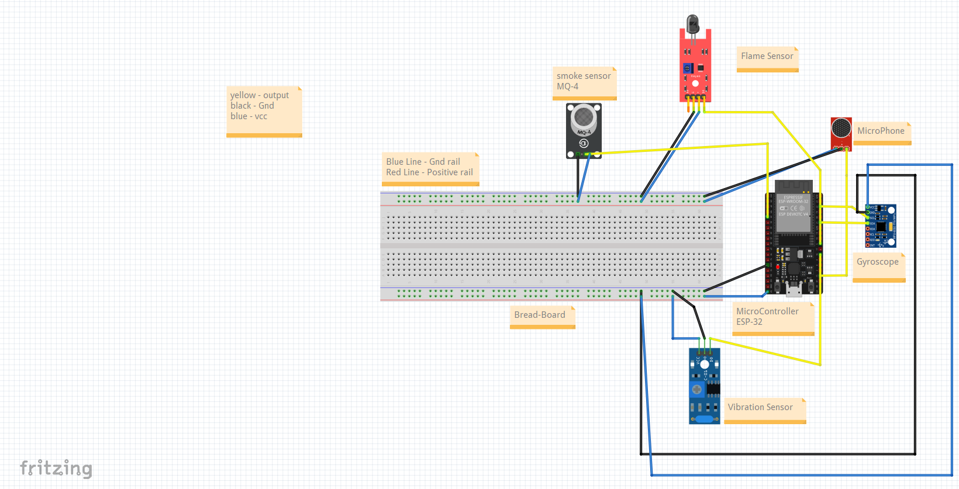
CIRCUIT DESIGN – FULL SYSTEM
Circuit Designs:
Full System Circuit Design:
Includes all five sensors (gas, flame, sound, vibration, and gyroscope) for general-purpose safety monitoring.
Residential Circuit Design:
Sensors used: Gas, Flame, Sound, and Vibration.
Designed specifically for home environments, such as kitchens, where gas leaks and fire risks are primary concerns.
Industrial/Bridge Circuit Design:
Sensors used: Vibration, Flame, and Gyroscope.
Optimized for monitoring structural integrity and fire hazards in critical infrastructure like bridges.
OUTPUT PINS :
SOUND SENSOR - D15 (DIGITAL OUTPUT)
VIBRATION SENSOR - D16 (DIGITAL OUTPUT)
FLAME SENSOR - D5 (DIGITAL OUTPUT)
GAS SENSOR (MQ-4) - A0 OR GPIO34 (ANALOG OUTPUT)
GYROSCOPE-
SCL → CONNECT TO GPIO22 (SCL) ON ESP32.
SDA → CONNECT TO GPIO21 (SDA) ON ESP32.

Slide 5
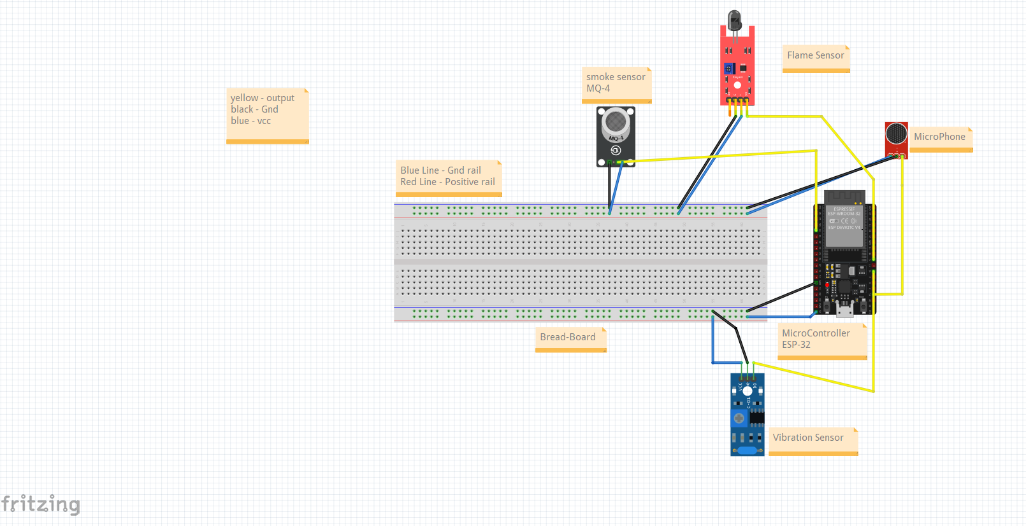
CIRCUIT DESIGN – RESIDENTIAL SETUP
Circuit Designs:
Full System Circuit Design:
Includes all five sensors (gas, flame, sound, vibration, and gyroscope) for general-purpose safety monitoring.
Residential Circuit Design:
Sensors used: Gas, Flame, Sound, and Vibration.
Designed specifically for home environments, such as kitchens, where gas leaks and fire risks are primary concerns.
Industrial/Bridge Circuit Design:
Sensors used: Vibration, Flame, and Gyroscope.
Optimized for monitoring structural integrity and fire hazards in critical infrastructure like bridges.
OUTPUT PINS :
SOUND SENSOR - D15 (DIGITAL OUTPUT)
VIBRATION SENSOR - D16 (DIGITAL OUTPUT)
FLAME SENSOR - D5 (DIGITAL OUTPUT)
GAS SENSOR (MQ-4) - A0 OR GPIO34 (ANALOG OUTPUT)

Slide 6
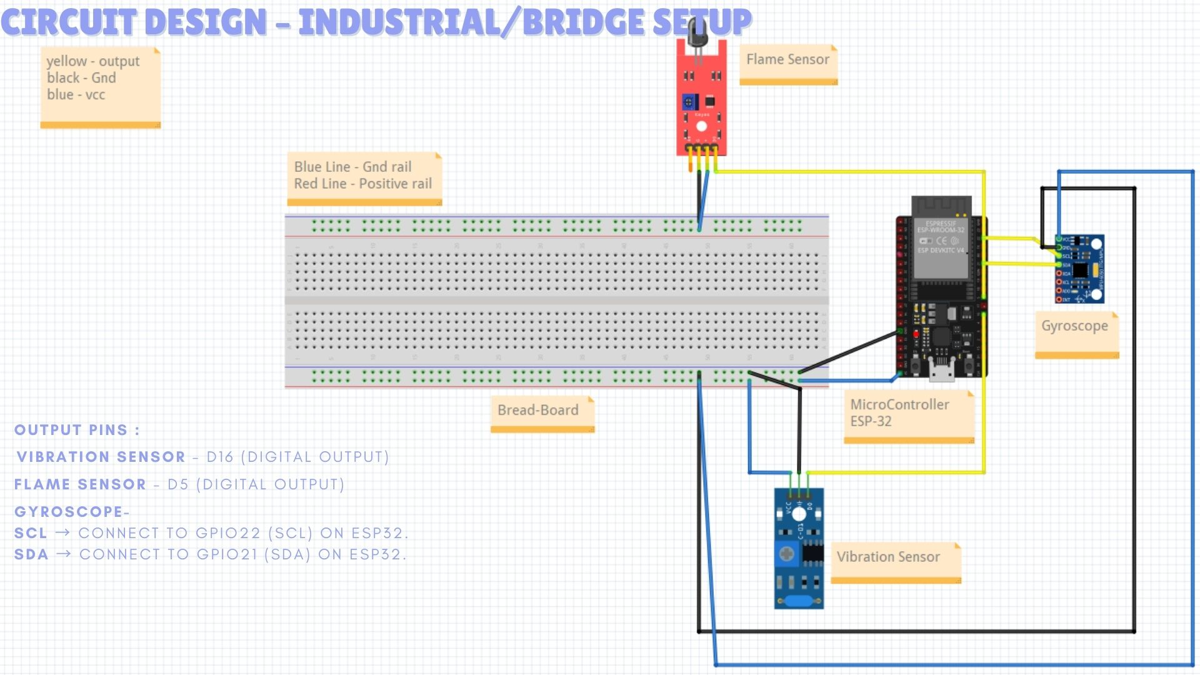
CIRCUIT DESIGN – RESIDENTIAL SETUP
CIRCUIT DESIGN – INDUSTRIAL/BRIDGE SETUP
Circuit Designs:
Full System Circuit Design:
Includes all five sensors (gas, flame, sound, vibration, and gyroscope) for general-purpose safety monitoring.
Residential Circuit Design:
Sensors used: Gas, Flame, Sound, and Vibration.
Designed specifically for home environments, such as kitchens, where gas leaks and fire risks are primary concerns.
Industrial/Bridge Circuit Design:
Sensors used: Vibration, Flame, and Gyroscope.
Optimized for monitoring structural integrity and fire hazards in critical infrastructure like bridges.
OUTPUT PINS :
VIBRATION SENSOR - D16 (DIGITAL OUTPUT)
FLAME SENSOR - D5 (DIGITAL OUTPUT)
GYROSCOPE-
SCL → CONNECT TO GPIO22 (SCL) ON ESP32.
SDA → CONNECT TO GPIO21 (SDA) ON ESP32.

Slide 7

AADIL HUSAIN – ALGORITHM DESIGN
Role in the Project:
Designed the flowchart to define how sensors interact with the ESP32 and ThingSpeak platform for hazard detection.
Flowchart Overview:
Sensor readings are collected and analyzed.
Threshold values trigger alerts via IoT.
Data is sent to ThingSpeak for real-time monitoring.

Slide 8
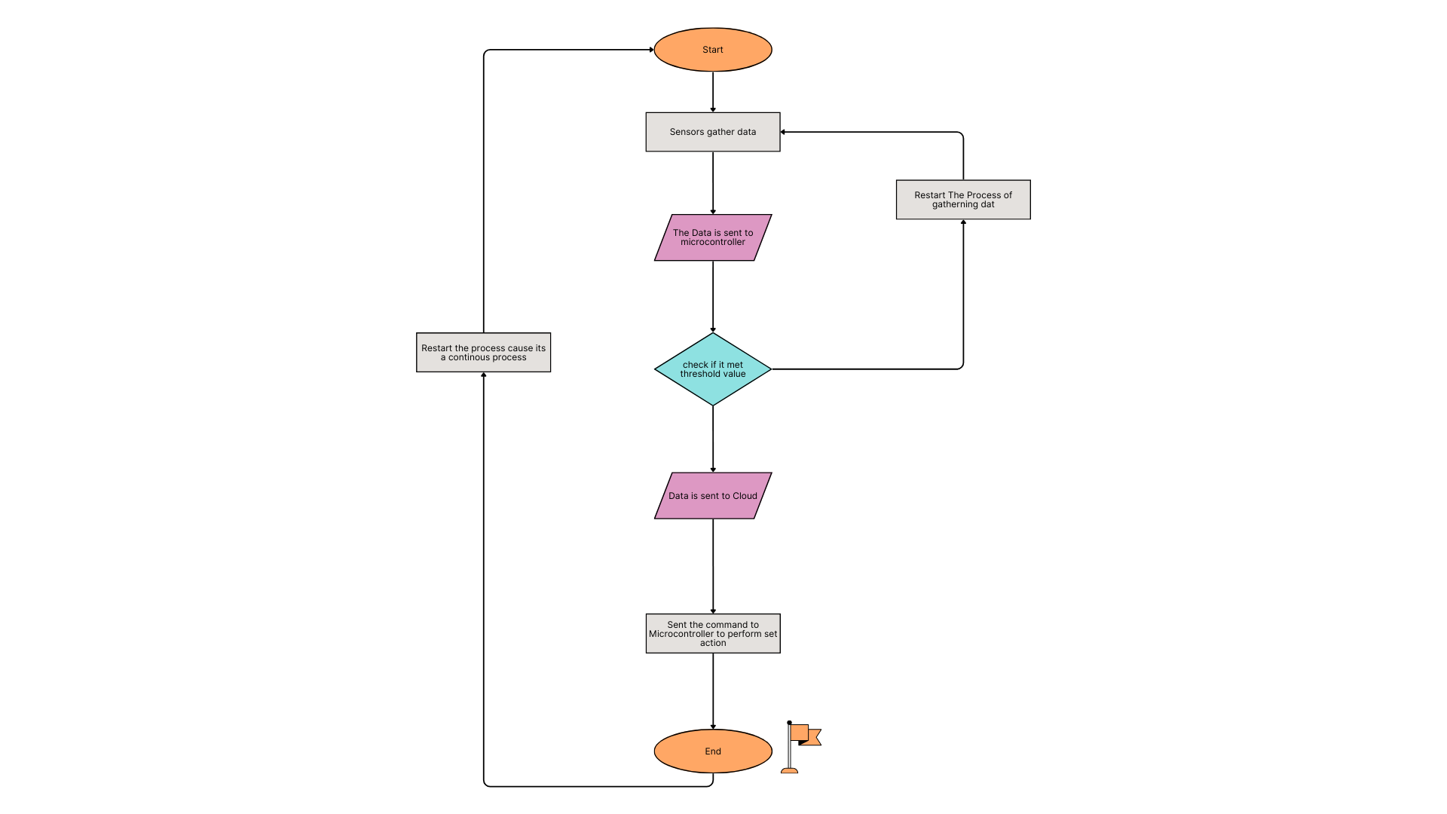
FLOWCHART DIAGRAM

Slide 9
SOURABH – RESEARCH AND REFERENCES
Role in the Project:
Conducted in-depth research to identify the most suitable sensors and technologies for the IoT-based safety device.
Collected references to guide the team in selecting best practices for sensor integration, hazard detection, and IoT communication protocols.
Key Contributions:
Researched the latest IoT safety devices and sensor technologies.
Compiled references for selecting sensors (gas, flame, vibration, sound, and gyroscope).
Provided valuable insights into the reliability and scalability of various IoT platforms (including ThingSpeak) for real-time data monitoring.

Slide 10
REFERENCES AND RESOURCES USED:
Reference: Ali, M., et al. (2020). "IoT-Based Fire Detection and Prevention Systems: A Review." Sensors, 20(6), 1686. https://doi.org/10.3390/s20061686
Contribution to the Project:
Range of Sensors: It provided information on the optimal range of gas sensors for detecting various gases in both confined (residential kitchens) and open (industrial environments) spaces.
IoT Communication: The research offered guidance on how IoT communication can be established for transmitting gas leak data to a central platform like ThingSpeak, ensuring remote monitoring.
Original Authors: Kumar, P., et al. (2021). IEEE Access.

Slide 11
REFERENCES AND RESOURCES USED:
Reference: Kumar, P., et al. (2021). "A Survey on Gas Leak Detection Systems using IoT." IEEE Access, 9, 11735-11753. https://doi.org/10.1109/ACCESS.2021.3056760
Contribution to the Project:
Addressing Multiple Hazards: This research helped us understand how to use multiple sensors (flame, smoke, and temperature) in conjunction to detect fires effectively in different environments.
Sensor Range: The paper highlighted the effective range of flame and smoke sensors for indoor and outdoor applications, guiding our selection of sensors for both residential and industrial setups.
Integration with IoT: It provided insights into how IoT platforms could be integrated for real-time monitoring and early alerts for fire hazards.
Original Authors: Ali, M., et al. (2020). Sensors.

Slide 12
REFERENCES AND RESOURCES USED:
Reference: Al-Kuwari, M. M., & Al-Mohammed, M. S. (2019). "Integration of IoT for Structural Health Monitoring Using Vibration Sensors." Journal of Sensors and Actuator Networks, 8(4), 48. https://doi.org/10.3390/jsan8040048
Contribution to the Project:
Range of Sensors: It provided insights into the effective ranges of vibration sensors, ensuring that they could detect subtle shifts in structure, especially in critical infrastructure.
Sensor Reliability: The paper emphasized the reliability and accuracy of vibration sensors for long-term monitoring, ensuring consistent data collection for safety systems.
Original Authors: Al-Kuwari, M. M., & Al-Mohammed, M. S. (2019). Journal of Sensors and Actuator Networks.

Slide 13
SAWAN KANKARWAL – FABRICATION
Role in the Project:
Designed and fabricated the Printed Circuit Board (PCB) to integrate all hardware components seamlessly.
Details of Fabrication Process:
Optimized sensor placement for efficient data collection.
Ensured durability and compactness for diverse applications.
Used standard PCB manufacturing tools to create a professional-grade board.

Slide 14
DEEPESH DHANWANI – CODING
Role in the Project:
Coded the ESP32 to interface with sensors and the IoT platform.
Utilized ThingSpeak for real-time data logging and alert systems.
Code Features:
Configured ESP32 for Wi-Fi connectivity and sensor integration.
Implemented data transmission to ThingSpeak.

Slide 15
CODE OVERVIEW
Wi-Fi Connection:
The device connects to a Wi-Fi network using the SSID and password.
Uses the WiFi.h library to manage Wi-Fi connections.
Sensor Setup:
Code Lines for setting up sensors:
pinMode(SOUND_SENSOR_PIN, INPUT); – Configures the sound sensor pin.
pinMode(VIBRATION_SENSOR_PIN, INPUT); – Configures the vibration sensor pin.
pinMode(FLAME_SENSOR_PIN, INPUT); – Configures the flame sensor pin.
pinMode(GAS_SENSOR_PIN, INPUT); – Configures the gas sensor pin.
Reads sensor data using:
int soundDetected = digitalRead(SOUND_SENSOR_PIN);
int vibrationDetected = digitalRead(VIBRATION_SENSOR_PIN);
int flameDetected = digitalRead(FLAME_SENSOR_PIN);
int gasLevel = analogRead(GAS_SENSOR_PIN);

Slide 16
CODE OVERVIEW
ThingSpeak Integration:
The code sends sensor data to ThingSpeak using the ThingSpeak.h library.
Data is sent via HTTP requests using an API key and channel ID.
Code Line: ThingSpeak.writeFields(channelID, apiKey);
Data Handling:
Reads and prints sensor values to the Serial Monitor.
Sends the sensor data to ThingSpeak every 15 seconds.
Error handling for API responses, ensuring proper communication.

Slide 17
AADIL HUSAIN – TESTING
Role in Testing:
Tested the system in two environments:
Kitchen Setup:
Focused on gas and flame sensors to detect leaks and fire risks.
Sound and vibration sensors monitored abnormal activity.
Vehicle Setup:
Monitored structural vibrations and high sound levels to assess vehicle integrity and safety.

Slide 18
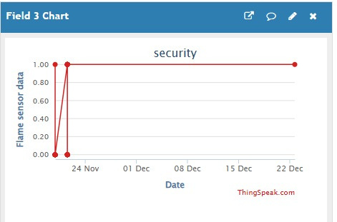
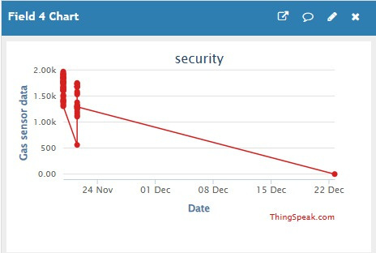
TESTING SCENARIO 1: OUTPUT GRAPH
SPIKE IN FLAME SENSOR
VARIATION AFTER TURNING ON LPG

Slide 19
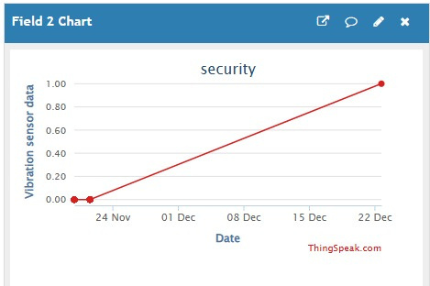
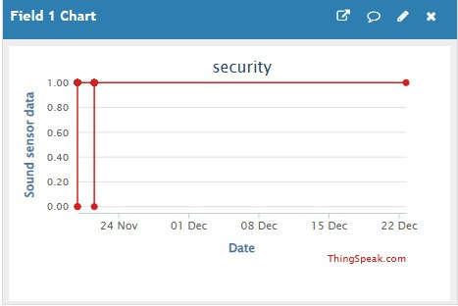
TESTING SCENARIO 2: OUTPUT GRAPH
DETECTING VIBRATION IN ON VECHILE
DETECTING SOUND IN ON VECHILE

Slide 20


FUTURE AND TRENDS
Additional Sensors: Integrating more sensors like smoke, carbon monoxide, and radiation for broader hazard detection.
Machine Learning: Implementing AI for predictive hazard analysis and real-time decision-making.
Edge Computing: Enhancing real-time data processing and reducing latency by processing data locally.

Slide 21
RESULT
Successfully integrated all sensors with the ESP32 microcontroller.
Real-time data monitoring and hazard detection were achieved using ThingSpeak.
Tested and verified functionality in diverse environments (kitchen and vehicle).

Slide 22





THANK
YOU

